Slide 1
The Poor Will Be Glad Chapter 7: Microfinance Goes Mainstream
Alissa Wachter
TUL 560 – Community Economics
February 2012

Slide 2
Microfinance Goes Mainstream
“Providing financial services, such as small loans,
to poor people so they can increase their income
and decrease their vulnerability to
unforeseen circumstances.
Muhammad Yunus wins Nobel Peace Prize in 2006
Most poor people in developing countries are “clinging to the edge of a cliff”
Small loans permanently improve conditions by allowing people to: buy in bulk, travel less, offer additional services, buy equipment, reduce labor costs, increase output
Notes:
Microfinance goes “mainstream” with Muhammad Yunus’ win of the Nobel Peace Prize in 2006 for his work in Bangladesh – changed common thinking on loaning to the poor, that they would not repay
Definition: “Providing financial services, such as small loans, to poor people so they can increase their income and decrease their vulnerability to unforeseen circumstances.”
Most poor in developing countries make living through small businesses based on cash: always “clinging to the edge of a cliff” with finances
With a small loan, they can buy in bulk, travel less frequently, stock more goods, offer additional services, buy equipment, reduce labor costs and increase output - permanently improving their conditions

Slide 3
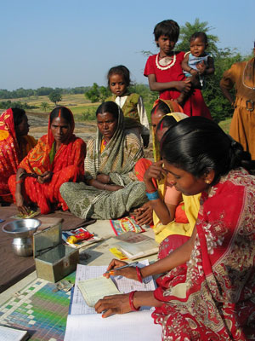
About the Loans
MFI’s (Microfinance Institutions) provide capital from donors or commercial lenders
Size: Generally 1/4-1/3 of country’s annual income
Terms: 6 months, paid weekly
Maximized impact: Funds recycled to other borrowers
Repayment: 95-98% repayment
Collateral: “social guarantee” and incentive
Notes:
MFI’s (Microfinance Institutions) provide capital from donors or commercial lenders (non or for profit).
Unlike banks, loan officers travel by foot or bike into the communities.
Size: vary depending on county; generally ¼ to 1/3 of the country’s annual income
Terms: typically 6 months, payments made weekly
Fund recycled to other borrowers, maximizing impact of money
Repayment: well-run MFI’s see 95-98% repayment; poor people lack physical collateral, but small groups ensure “social guarantee” (other members of group have to make up for it, known in the community) and incentive to get larger loans

Slide 4
What are the Interest Rates?
Primary criticism of microfinance
Average annual rate: 30-50% with (including fees and inflation)
Reasons for interest:
MFI’s self-sufficiency
Inflation
Most include training or health/emergency insurance
Notes:
Average annual rate: between 30 and 50% with fees included (think 10 to 25 plus inflation)
Primary criticism of microfinance, seems high to many people but:
Reasons: MFI’s need to be self-sufficient; inflation must be accounted for; most MFI’s include training or health/emergency is built into the loan

Slide 5
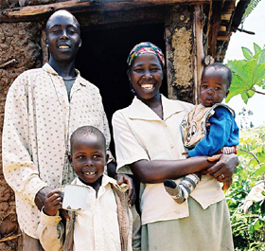
Women & Responsible Credit
80% worldwide go to women:
More likely to have a small business
More likely to repay
More likely to impact whole family
Less likely to be involved in income-negative activities
MFI’s provide training in responsible use of credit
Increasing income, not paying off other debt
Notes:
Approximately 80% of microloans made worldwide are to women: they are seen as more likely to have a small business, to repay due to commitment to the family, less likely to be involved in drinking or other income-negative activities; believe it is more likely to impact whole family
Training in the responsible use of credit and borrowing for purpose of increasing income (not paying off other debt or for consumer goods)

Slide 6
Trends and Events
Donors: Difficult to secure long-term; fundraising requires time & money
Profits: MFI’s can make a profit; sometimes means higher interest or reduced services
Commercial services: MFI’s can borrow money from outside sources (i.e. banks); easier to access than donor $ but can mean higher interest or decreased services
Notes:
Donors: Can be difficult to secure long-term donors and expenses may go toward securing them
Profits: can make a profit, though sometimes at expense of higher interest rates or reduced services
Commercial services: MFI’s can borrow money from outside sources (i.e. banks) to increase loan portfolio. Easier to access than donor money but can mean higher interest or decreased services.

Slide 7
Does Microfinance Work?
MFI’s can be easily replicated
As size increases, so do overhead costs reduce
Emerging research and anecdotal evidence shows impact on communities
Seeing it in action is the best way to understand impact
Notes:
MFI’s can be replicated and scaled relatively simply in a diversity of countries and settings
As an MFI increases in size, overhead costs are reduce
Research emerging suggests that it does (examples across the world)
Seeing MFI’s in action is the best way to understand their impact on lives and communities

Slide 8
The End…

